Slide 1
DOE Bioenergy Technologies Office 2019 Project Peer Review: The Waste-to-Energy System Simulation Model (WBS# 2.1.0.104)
Daniel Inman, PhD
March 5th, 2019
NREL

Slide 2
Project Goals
Goal: to use systems thinking and analyses to generate non-trivial system insights around the development of the industry and to use these insights to inform the R&D opportunities.
Outcomes:
A state-of-the art computational model of the waste-to-energy (WTE) industry in the U.S.
Analyses that uncover non-intuitive system insights and endogenous behaviors
Dissemination of our findings to stakeholders
Relevance: This project is relevant to BETO and the broader stakeholder community because we develop and disseminate actionable insights about the nascent WTE industry (e.g., identifying bottlenecks, synergies, impacts of R&D decisions, local/regional implications, and areas of leverage) and the long-term potential of WTE technologies. Outcomes from this project inform R&D opportunities.
Notes:
*use systems thinking and modeling to better understand the developing WTE industry in the US
Outcomes – SD model
Analyses that reveal non-intuitvie insights
Dissemination of our work to the broader WTE community
This project is relevant because the WTE is developing while at the same time novel WTE technologies are being developed. Our work identifies opportunities, synergies, and bottle necks to the development of the industry

Slide 3
Quad Chart Overview
Timeline
Project Start: 10/1/2017
AOP Cycle End: 9/30/2020
Amount Complete: ~50%
Barriers addressed
At-A: Comparable, Transparent, and Reproducible Analyses . The WESyS model is transparent, reproducible, and trackable.
At-B: Analytical Tools and Capabilities for System-Level Analysis. WESyS is a systems modeling tool built using established approaches and data.
At-C: Data availability across the Supply Chain
 | FY 18 Costs | FY 19 Costs | FY 20 Costs | Total Planned Funding
DOE Funded | $300K | $300K | $300K | $900K
Partners: Pacific Northwest National Laboratory, Lexidyne LLC, Environmental Protection Agency
Objective: to build and exercise a system dynamics (SD) model of the waste-to-energy (WTE) industry in the United States and to develop and analyze scenarios that explore the evolution of the WTE industry and how it may be deployed in a way makes a substantial contribution to the country’s transportation energy. We want to understand how novel technologies develop in the context of multiple mature technologies.
End of Project Goal: to directly addresses specific Bioenergy Technologies Office questions, we will expand the model to include a range of developing technologies and novel sources of waste feedstocks.
Notes:
On going project
Began as a collaboration with EPA
Partners include PNNL, EPA
End of project goal : completed and vetted SD model of the WTE system in the US along with a suite of analyses that explore specific BETO/community questions

Slide 4
1 – Project Overview

Slide 5
Simulating Industrial Trajectories
Our model, the waste-to-energy system simulation (WESyS) model, tracks technological investments and energy production from landfills, publicly-owned treatment works (POTWs), and concentrated animal feeding operations (CAFOs) in two U.S. regions – California (CA) and the rest of the U.S. (ROTUS).
We have collaborated extensively with scientists from the U.S. Environmental Protection Agency as well as with other national labs.
The model is built using peer-reviewed data for resource potential and process techno-economics.
Investment and buildout of the industry is tracked throughout a simulation.
Results are a snapshot of the industry at a point in time or the development trajectory over time.
Notes:
WESyS is an SD model that tracks technology investment across two US regions (CA and Rotus) for landfills, CAFOs, and POTWs
Investment and buildout of the industry is tracked through time in a given simulation, results are a snapshot of the development trajectory over time
Explain why we are focused on CA and ROTUS
The model is build using publicly available peer reviewed data
We have collaborated extensively with the EPA

Slide 6
2 – Approach

Slide 7
Personnel and Responsibilities
Team members and responsibilities
Daniel Inman, PhD – Project task lead and analyst
Annika Eberle, PhD – Lead analyst
Laura Vimmerstedt, MS – Senior Analyst
Ling Tao, PhD – Analyst/process design liaison
Arpit Bhatt, MS - Analyst/process engineer
Dylan Hettinger – Programmer
Steve Peterson (Consultant) – Lead model architect
Notes:
Our team has extensive experience in:
System dynamics modeling
Statistical computing
High performance computing and database
Chemical engineering
Policy analysis

Slide 8

Management Workflow
Regularly interface with partners and subcontractors (PNNL, Lexidyne, BETO)
Monthly team meetings
Regularly scheduled calls with BETO
Experiential modeling sessions with stakeholders
Quarterly AOP milestones
Database management best practices
State-of-the-art workflow
Study versioning – reproducibility
Quantitative QA/QC on models
NREL’s HPC System
Notes:
We have regular meetings with our BETO technology manager, including analysis briefings and interactive modeling and visualization demos
Regular meetings with our subcontractor and team
We use industry standard best practices for model building, analysis, coding, database management, and versioning

Slide 9
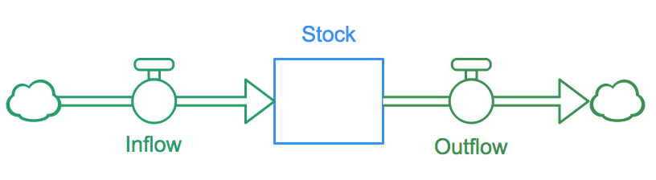

System Dynamics Modeling
We use system dynamics to model the waste-to-energy (WTE) system in the U.S.
System dynamics is a modeling approach that uses coupled ordinary differential equations to represent complex (non-linear) systems.
SD was developed at MIT in the 1940s by Jay Forrester and has been applied to a variety of problems at several large organizations (e.g., GE, GM, U.S. Navy, U.S. DOE).
SD practitioners use systems thinking, management insights, and computation to hypothesize, test, and refine endogenous explanations of system change.
Notes:
WESyS is built using system dynamics
SD was originally developed at MIT in the 1940s for modeling non-linear feed back systems – radar control
It has since been used extensively in industry and government to model complex systems including policy and environment
SD uses a system of coupled ODEs to represent the concepts of stocks and flows
SD modeling uses systems thinking along with modeling to uncover endogenous system behavior (non trivial insights)

Slide 10
WESyS is Focused on Endogenous Behavior
Industry Development
Multiple Technologies
Learning Curve Dynamics
Energy Production
Regulatory Environment
(RINs, SB1383, PTC, RECs, Rate Basing)
Maturity in terms of…
Production Credits
Other Environmental Incentives
Process Yield
Input Capacity
Capital Cost Growth
Investor Risk Premium
Debt Financing Access
Incentives
Capacity Additions
Financials
CA
ROTUS
Multiple Technologies
Pro Forma Financials
Net Present Value of “Next” Plant
(+)
TEA and Exogenous
Reinforcing feedback
Industry Production and Capacity
Multiple Technologies
Allocation of Plant Construction Capacity
Initiation of Construction of Discrete Plants
Net Present Value of “Next” Plant
Availability
Resources
(WWTP, LF, CAFO)
We use exogenous parameters such as technoeconomics and
existing policies as model inputs.
Notes:
Walk through the influence diagram here

Slide 11
Success Factors
Success factors
Ground truth technical and economic model assumptions
Balance detail complexity with computational efficiency
Stakeholder buy-in on vetting and calibration
Accurately represent the complex decision process around investment in WTE
Understand the nuanced market for energy products from WTE systems
Challenges
Consistent and verified data
Anticipating analyses that are relevant to the industry.
Notes:
Use knowledge of system behavior and input from domain experts to build and populate models of the waste-to-energy (WTE) system.
Develop models using a flexible, transparent, and modular architecture.
Conduct rigorous statistically based sensitivity and model validation.
Use only vetted resource, market, and techno-economic data.
Challenges
Consistent and verified data
Anticipating analyses that are relevant to the industry.

Slide 12
3 – Technical Accomplishments and Results
Large Sensitivity Study of WESyS
Q3 & Q4 FY 2018

Slide 13
Accomplishments: Milestones
All planned milestones have been met and delivered on schedule
We built and tested a system dynamics model of the waste-to-energy system in the U.S.
We developed a state-of-the-art workflow for executing large studies, cataloging results, and analyzing data.
We analyzed the energy fates of biogas and sludge in California and the Rest of the U.S. (ROTUS) were assessed.
We have conducted several state of the art interactive analysis and visualization workshops for our BETO clients.
We have developed a suite of real-time statistical analysis tools for use with WESyS and other similar models.
Completed a large sensitivity study of the model
The next several slides will present results from our recent sensitivity study.
Notes:
Built an SD model
Developed a state of the art workflow around the data model and analysis
Conduced several studies examining the energy fates for CA and rotus WTE systems
Data cave
Statistical tools

Slide 14
Results: Sensitivity Study of WESyS
Our objective is to understand the technical, economic, and local conditions that lead to specific end fates of biogas and biosolids.
Plant configurations considered:
No waste-to-energy (WTE)
Flaring
Combined heat and power (CHP)
Electricity (Elec)
Compressed natural gas (CNG)
Renewable natural gas (RNG)
Hydrothermal liquefaction (HTL)
CAFO
Fuel via HTL
Anaerobic
Digestion
BioGas
Flare
POTW
CHP
Fuel via HTL
Electricity
CNG
Landfill
RNG
Notes:
State objectives
Briefly explain the investment options and explain the figure on the right

Slide 15
Results: Factors Varied in Study
Learning
Commercial progress ratio for HTL
Exogenous production of HTL
Initial commercial maturity of HTL
Commercial experience for learning
Policy
Production tax credits
RIN price
Rate based investment for electricity
Grant for PNG interconnect
Diversion of organics via SB1383
TEA and Exogenous
Expected operating cost
Expected fixed capital investment
Conversion efficiencies
Coproduct sales revenue
Debt interest rate
Depreciation period
Expected equity fraction
Pipeline length
Required rate of return
Tipping fee
Dwell time
Fuel prices
Notes:
Quickly state that a number of factors were varied including policy, learning, and tea
We used a large combinatorial design which resulted in ~ 1.5 MM individual simulations

Slide 16
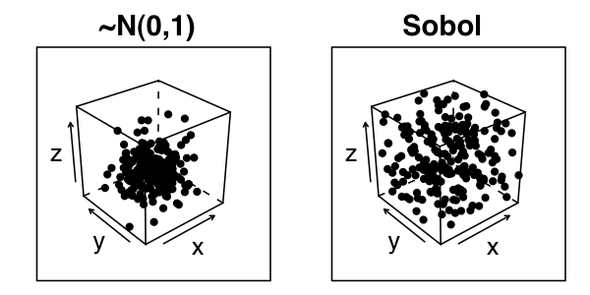
Results: Study Design and Analysis
We used Sobol’s quasi-random sequences to design two studies (CA and ROTUS) with ~65 factors and 7,500 replications each (~1 million runs per study).
Global Sensitivity Analysis: We determined the total, first, and second-order sensitivity indices using variance-based decomposition.
Local sensitivity analysis: We performed Mood’s Median test on specific regions of interest.
Comparison of a Gaussian sampling
distribution to Sobol’s Quasi Random
Sequence.

Slide 17
Results: Summary of CA Energy Trends
Blue = all sensitivity results
Red = model default results
Notes:
Across the three sources of biogas assessed in this analysis, landfills have the largest energy production potential, followed by CAFOs. For CAFOs and POTWs in CA, CHP produces the greatest amount of energy, while electricity is the most productive technology for landfills.
In CA, we do see some takeoff for HTL, particularly for CAFOs.

Slide 18
Results Among Biogas Sources: CA
Biogas Source | Model Factor | S_{ti}
POTW | CHP Efficiency | 0.15 d
 | HTL Technology Demo. | 0.30 a
 | HTL Comm. Maturity | 0.23 b
 | HTL Pre-Comm Maturity | 0.27 ab
 | Anaerobic Digester Yield | 0.23 b
CAFO | Rate of Return | 0.20 b
 | HTL Technology Demo | 0.32 a
 | HTL Comm. Maturity | 0.27 a
 | HTL Pre-Comm Maturity | 0.29 a
 | HTL Learning Rate | 0.22 b
Landfill | CH₄ Recovery | 0.73 a
HTL is attractive for manure and sludge once sufficient demoing has been done.
Maturity is very important for HTL to be attractive in the WTE space b/c the incumbent technologies are proven and mature.
These results are not directional – competitive interactions are present
In terms of non-intuitive insights, we found that the tipping fee, and certain incentives are not among the top influential factors.
Notes:
More here on competition between HTL and others

Slide 19
4 – Project Relevance

Slide 20
Relevance to Stakeholders
Relevance to BETO
“to develop industrially relevant, transformative, and revolutionary bioenergy technologies to enable sustainable, domestically produced biofuels, bioproducts, and biopower for a prosperous nation. “
In order to meet the above goal, decision makers and technologists need to understand where to focus their efforts, what hurdles exist, and how to minimize them.
“generates scientific knowledge that proactively addresses issues affecting the scale-up potential, public acceptance, and long-term viability of advanced bioenergy systems. “
For novel, revolutionary technologies to thrive, we need to provide them with knowledge gained through experiential learning without the exposing them to the potentially catastrophic risks.
WESyS does just that – it acts as a flight simulator that allows researchers to experiment, fail, succeed, and gain industrial knowledge about the WTE industry in the process. They can then leverage this knowledge to make better and more informed decisions.

Slide 21

Relevance to Stakeholders
WTE Community
Provide outreach and analysis to key stakeholders
We have provided briefings to agencies such as the California Air Resources Board on our results, contributed key analysis to BETO’s challenges and opportunities report, participated in DOE-led industry workshops (Golden, CO & Berkeley, CA)
We have utilized advanced visualization and computation to conduct experiential modeling and analysis sessions with BETO and the broader WTE community (e.g., Waste Management Inc.).
WESyS being run in 3-D mode in NREL’s advanced visualization center.

Slide 22
Looking Forward
To increase our relevance and provide the most impactful project outputs, we have focused the remaining 18 months on increasing the detail complexity represented in the model and understand the system-wide implications. Additionally, we will be working with process engineers/developers to include additional novel technologies.
Specifically we will perform the following activities:
Fundamentally change the technology investment decision framework in the model to allow for:
technological investments that are less than the maximum throughput
multiple, sequential technology investments
This will allow us to better represent the current status of the industry where projects may invest in a given technology and at a later date, expand the existing investment, or invest in a different technology.
Key milestones:
Q4 FY19 - Understand the system-wide implications of multiple-technology investments at individual facilities. This will exercise the additional WESyS model structure and logic to that was added in Q2 and Q3 (allowing facilities to invest in more than one WTE technology) by performing an analysis to explore how this affects the buildout of the WTE industry over time.
Go/No-Go milestones:
Q1 FY20 - Critical model review. Are the analyses and model relevant for BETO and the stakeholder community at large?

Slide 23
Summary
Overview: WESyS dynamically evaluates potential waste-to-energy feedstocks, technologies, and end uses using a scenario-based approach. Results from this project enable the development of insights into potential industry growth and market penetration, particularly with respect to policies, incentives, technological advances (R&D, industrial learning), related and/or competing energy markets, demand for petroleum-based fuels, and competing uses of feedstock.
Approach: WESyS uses a system dynamics modeling framework. The model is built from vetted and/or published resource, market, and techno-economic data. A flexible, modular, and transparent architecture is used.
Accomplishments: All milestones completed. Developed a state-of-the-art approach modeling approach, impactful analyses on biogas and sludge, large-scale sensitivity studies completed.
Relevance: WESyS is a flight simulator that allows researchers to experiment, fail, succeed, and gain industrial knowledge about the WTE industry in the process. They can then leverage this knowledge to make better and more informed decisions.
Future Work: Increasing relevance by adding real-world detail complexity and understanding the impacts of multiple investments at facilities and assessment of food wastes and emerging technologies.

Slide 24
Thank you
This work was authored by the National Renewable Energy Laboratory, operated by Alliance for Sustainable Energy, LLC, for the U.S. Department of Energy (DOE) under Contract No. DE-AC36-08GO28308. Funding provided by U.S. Department of Energy Office of Energy Efficiency and Renewable Energy. The views expressed in the article do not necessarily represent the views of the DOE or the U.S. Government. The U.S. Government retains and the publisher, by accepting the article for publication, acknowledges that the U.S. Government retains a nonexclusive, paid-up, irrevocable, worldwide license to publish or reproduce the published form of this work, or allow others to do so, for U.S. Government purposes.
Notes:
*Author: Insert the words “In part” if your research is funded by entities outside of DOE. The wording would say, This work was authored in part by the Alliance . . .
**Author: insert applicable Department of Energy office and program office, e.g., U.S. Department of Energy Office of Science or U.S. Department of Energy Office of Energy Efficiency and Renewable Energy Solar Energy Technologies Office (spell out full office names; do not use initialisms/acronyms)].

Slide 25
Additional Slides

Slide 26
Peer Review 2017 Comments and Responses
Comments regarding lack of rationality and inadequate stakeholder engagement:
Based on feedback from the reviewers we have decided to modify our work plan for the remainder of FY17, going into FY18. Our focus for Q3 and Q4 has changed and will now be to: 1) regionalize the WESyS model, and 2) perform a preliminary scenario analysis that is informed by input from the July 2017 WTE Workshop. Specifics of our new approach are as follows. In order to develop a regionalized WESyS model that is relevant for application to the WTE industry, we would will include four stages of stakeholder engagement in our model development. The first stage will involve presenting the model at the July 2017 WTE Workshop in California. During this presentation, we will provide an overview of the structure and capabilities of WESyS and answer questions about the model. In the second stage, we would like to have several breakout sessions with stakeholders at the workshop in order to solicit feedback regarding emerging issues surrounding WTE policy and technology. These sessions would ideally be hosted by BETO with members of the WESyS team there to facilitate the discussion. Topics could include how stakeholders might use the WESyS model, the relevance of the model’s technology types, current and future policy and regulatory frameworks, and other important frameworks that could be incorporated into WESyS in the future. Stage three would involve using the stakeholder feedback to develop the research questions and analysis scenarios for Q4. This stage would involve working with BETO to 1) synthesize stakeholder input from the workshop into actionable scenarios, 2) rank the scenarios based on BETO priorities, 3) down-select to a maximum of four scenarios for analysis in Q4, and 4) identify future directions and scenarios that could potentially be explored in FY18. The outcomes of stage three would include a refined scenario design and the identification of a baseline set of conditions (examples below; final selection will be based on feedback from CA Workshop).
Regional differences in technologies, capex, opex: While we strive to have the most representative data, the model is a high-level systems model and will not represent all potential differences between technologies and regions. That said, because of the architecture, it is flexible enough to perform case study or sub-regional analyses in which such variance could be assessed.
Transition dynamics vs prediction: SD is designed to understand system feedbacks. The WESyS model is geared towards understanding how the system may respond to specific scenarios or sets of scenarios. Output from the model should be viewed as directional and order-of-magnitude as opposed to precise point predictions because we do not necessarily represent statistical relationships (i.e. there are no error bars associated with our output).
Sufficient redundancy: Although the lead model architect is one person, our team has decades of combined experience in system dynamics modeling and analysis. There are at least three other individuals on the team that could serve as lead architect if needed.

Slide 27
Sensitivity Study – Additional Detail

Slide 28
Milestone Information
WBS #: 2.1.0.104
Milestone title: A briefing, in the form of a presentation, on the technoeconomics, policy drivers, and market conditions that lead to specific end fates of biogas. This briefing will discuss key drivers that lead to direct conversion to fuels/products, anaerobic digestion followed by: flaring, combined heat and power, pipeline injected renewable natural gas, compressed natural gas, and biofuels/products.
Due date: 9/30/2018
Completion date: 9/25/2018
Details:

Slide 29
Producing Energy from Biogas in the U.S.: System Levers and Bottlenecks
Daniel Inman, Annika Eberle,
Laura Vimmerstedt, and Dylan Hettinger
09.25.2018

Slide 30
Overview
Study introduction
Approach
Global sensitivity results for specific cases
Local sensitivity results for select regions
Discussion and summary
Next steps and future work

Slide 31
Introduction
This study focuses on the energy fate of biogas collected from publicly owned treatment works (POTWs), landfills, and confined animal feeding operations (CAFOs) in California (CA) and the rest of the U.S. (ROTUS). We also include results for fuel produced via HTL.
Plant configurations considered:
No waste-to-energy (WTE)
Flaring
Combined heat and power (CHP)
Electricity (Elec)
Compressed natural gas (CNG)
Renewable natural gas (RNG)
Hydrothermal liquefaction (HTL)
CAFO
Fuel via HTL
Anaerobic
Digestion
BioGas
Flare
POTW
CHP
Fuel via HTL
Electricity
CNG
Landfill
RNG
Notes:
We included HTL because we updated the HTL TEA
Competing for limited resources
HTL – technology development/learning in the context of mature technologies.

Slide 32
Objective
Our objective is to understand the technoeconomics, policy, and regulatory conditions that lead to specific end fates of biogas.
To explore these issues, we performed global and local sensitivity analyses on NREL’s Waste to Energy System Simulation (WESyS) model.
Source: East Bay Municipal Utility District

Slide 33
Approach

Slide 34
Influence Diagram for WESyS
Industry Development
Multiple Technologies
Learning Curve Dynamics
Energy Production
Regulatory Environment
(RINs, SB1383, PTC, RECs, Rate Basing)
Maturity in terms of…
Production Credits
Other Environmental Incentives
Process Yield
Input Capacity
Capital Cost Growth
Investor Risk Premium
Debt Financing Access
Incentives
Industrial Learning
Capacity Additions
Financials
CA
ROTUS
Multiple Technologies
Pro Forma Financials
Net Present Value of “Next” Plant
Regional
(+)
TEA and Exogenous
Reinforcing feedback
Industry Production and Capacity
Multiple Technologies
Allocation of Plant Construction Capacity
Initiation of Construction of Discrete Plants
Net Present Value of “Next” Plant
Availability
Resources
(WWTP, LF, CAFO)
Current State of the Industry

Slide 35
Factors Varied in Study
Learning
Commercial progress ratio for HTL
Exogenous production of HTL
Initial commercial maturity of HTL
Commercial experience for learning
Policy
Production tax credits
RIN price
Rate based investment for electricity
Grant for PNG interconnect
Diversion of organics via SB1383
TEA and Exogenous
Expected operating cost
Expected fixed capital investment
Conversion efficiencies
Coproduct sales revenue
Debt interest rate
Depreciation period
Expected equity fraction
Pipeline length
Required rate of return
Tipping fee
Dwell time
Fuel prices

Slide 36
Study Design and Analysis
We used Sobol’s quasi-random sequences to design two studies (CA and ROTUS) with ~65 factors and 7,500 replications each (~1 million runs per study).
Global Sensitivity Analysis: We determined the total, first, and second-order sensitivity indices using variance-based decomposition.
Local sensitivity analysis: We performed Mood’s Median test on specific regions of interest.
Comparison of a Gaussian sampling
distribution to Sobol’s Quasi Random
Sequence.

Slide 37
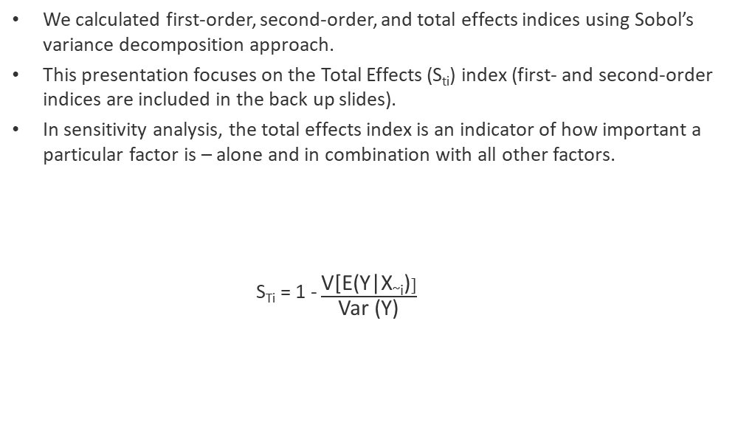
Variance Decomposition
We calculated first-order, second-order, and total effects indices using Sobol’s variance decomposition approach.
This presentation focuses on the Total Effects (S_{ti}) index (first- and second-order indices are included in the back up slides).
In sensitivity analysis, the total effects index is an indicator of how important a particular factor is – alone and in combination with all other factors.
S_{Ti} = 1 - $\frac{\text{V}\text{[}\text{E}\text{(}\text{Y}\text{|}\text{X}\text{\sim }\text{i}\text{)}]}{\text{Var}\text{ (}\text{Y}\text{)}}$
Expected value of the conditional variance = the average conditional variance for X_{i (1, N)}
Conditional variance in model output for measure A; factor X_{i} is fixed at a constant value.
Variance in model output for measure A; all factors varied.
Notes:
Sti = Total effects index for factor “I”
V = variance
E = expected value
Y = dependent variable (model output)
X = independent variable (model factor)

Slide 38
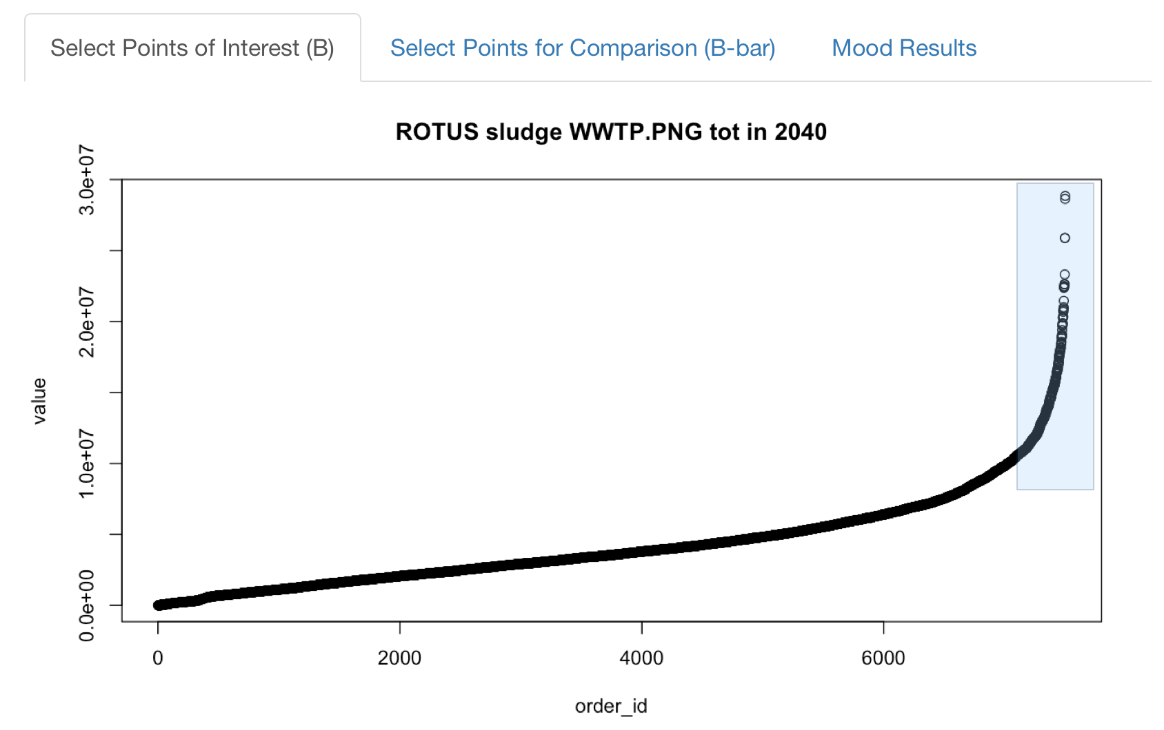
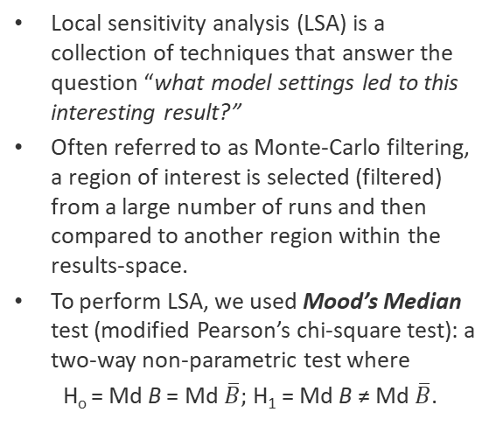
Local Sensitivity
Local sensitivity analysis (LSA) is a collection of techniques that answer the question “what model settings led to this interesting result?”
Often referred to as Monte-Carlo filtering, a region of interest is selected (filtered) from a large number of runs and then compared to another region within the results-space.
To perform LSA, we used Mood’s Median test (modified Pearson’s chi-square test): a two-way non-parametric test where
H_{o} = Md B = Md $\overline{B};$H₁ = Md B ≠ Md $\overline{B}$.
?
Notes:
Ho = null hypothesis
H1 = alternative hypothesis
Md = median
B = group of interest
B bar = group to compare B against

Slide 39
High-Level Summary of Results

Slide 40
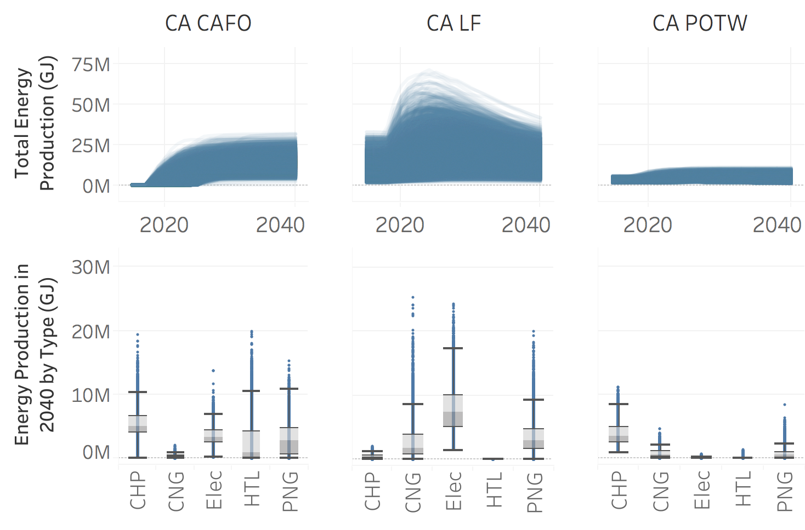
Summary of CA Biogas Trends
All sensitivity runs
Model default run
Notes:
Across the three sources of biogas assessed in this analysis, landfills have the largest energy production potential, followed by CAFOs. For CAFOs and POTWs, CHP produces the greatest amount of energy, while electricity is the most productive technology for landfills.
In CA, we do see some takeoff for HTL, particularly for CAFOs. <<<more here

Slide 41
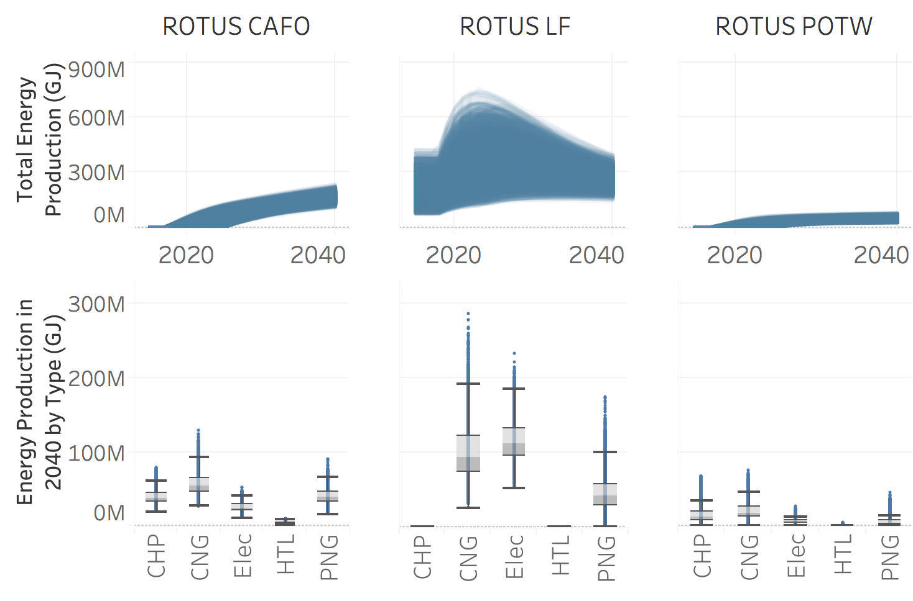
Summary of ROTUS Biogas Trends
All sensitivity runs
Model default run
Notes:
Trends across sources and technologies is somewhat different in ROTUS as compared to CA. CNG is the dominant technology for CAFOs and POTWs. Electricity is the dominant technology for landfills, with CNG very close behind.
Include a reference line for 2040 high, and CA
Reference showing default

Slide 42
Summary of Impactful System Factors
Learning
TEA
Demo-scale learning for HTL
Commercial maturity for HTL
Learning rate for HTL
Amount of recovered CH₄ from landfills
CNG efficiency and yield
Digester yield
Rate of return
Policy
Project delays
Production credits
Energy prices (elec, NG, oil)
Notes:
Present results in the above categories

Slide 43
Results
Global sensitivity analysis

Slide 44
Orientation and Caveats
On the following slides we will present results in the following order:
Insights among technologies within regions
Comparisons among technologies between regions
General caveats include:
Fixed capital will be installed on-site
Facilities that invest in technology other than flare can not invest again except for POTWs in which the capital is retired/expired
There is no mechanism to move waste offsite – i.e. consolidate waste from multiple outlets
RINs, RECs, and LCFS credits do not expire
HTL nth plant design case is based on PNNL (2016/PNNL-25464): biocrude from sludge case (Table 6)
We do not have the full range of CA policies that may impact WTE
We vary the commercial maturity for HTL from 0 to 1 even though it is not commercially mature (at present, it is arguably non-zero).

Slide 45
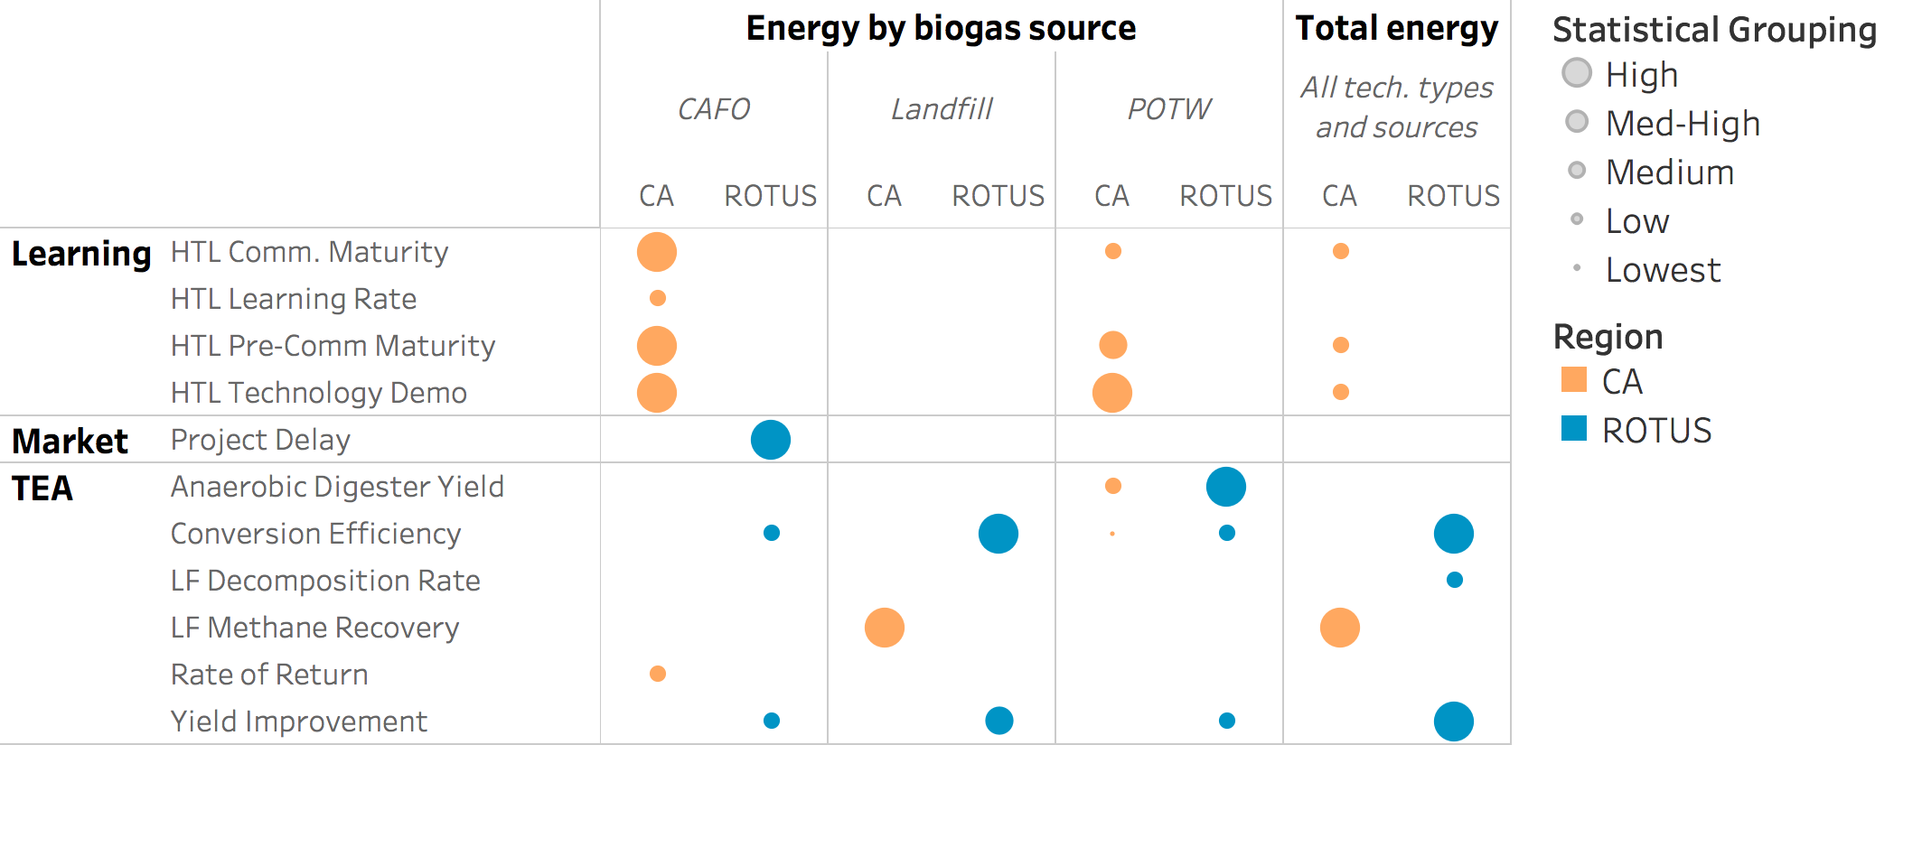
Results by Biogas Source
Notes:
Methane recovery impacts active vs inactive differently. In CA there are more inactive than active182 vs 115, in ROTUS they are evenly split 1061 vs 1062

Slide 46
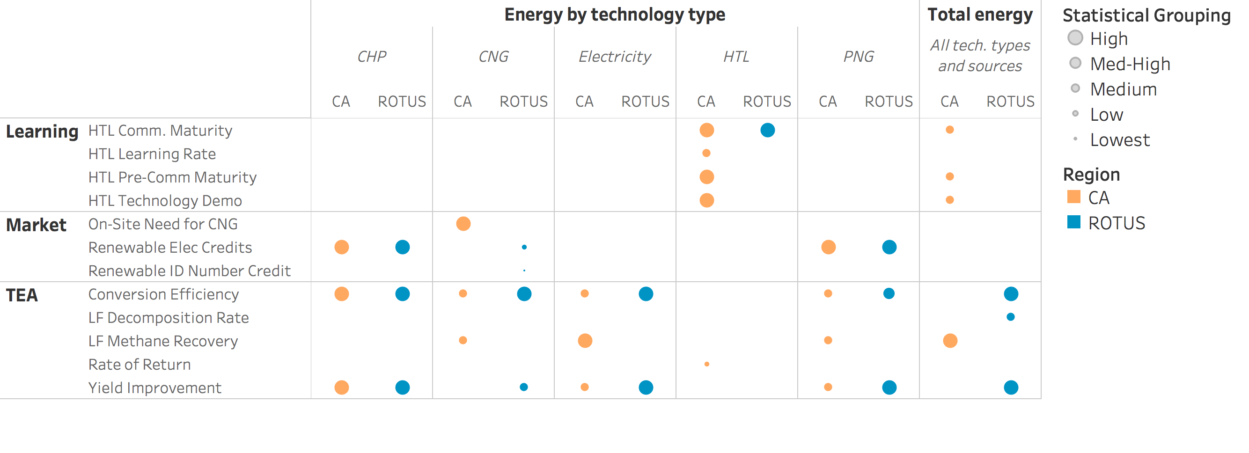
Results by Technology

Slide 47
CA Results

Slide 48
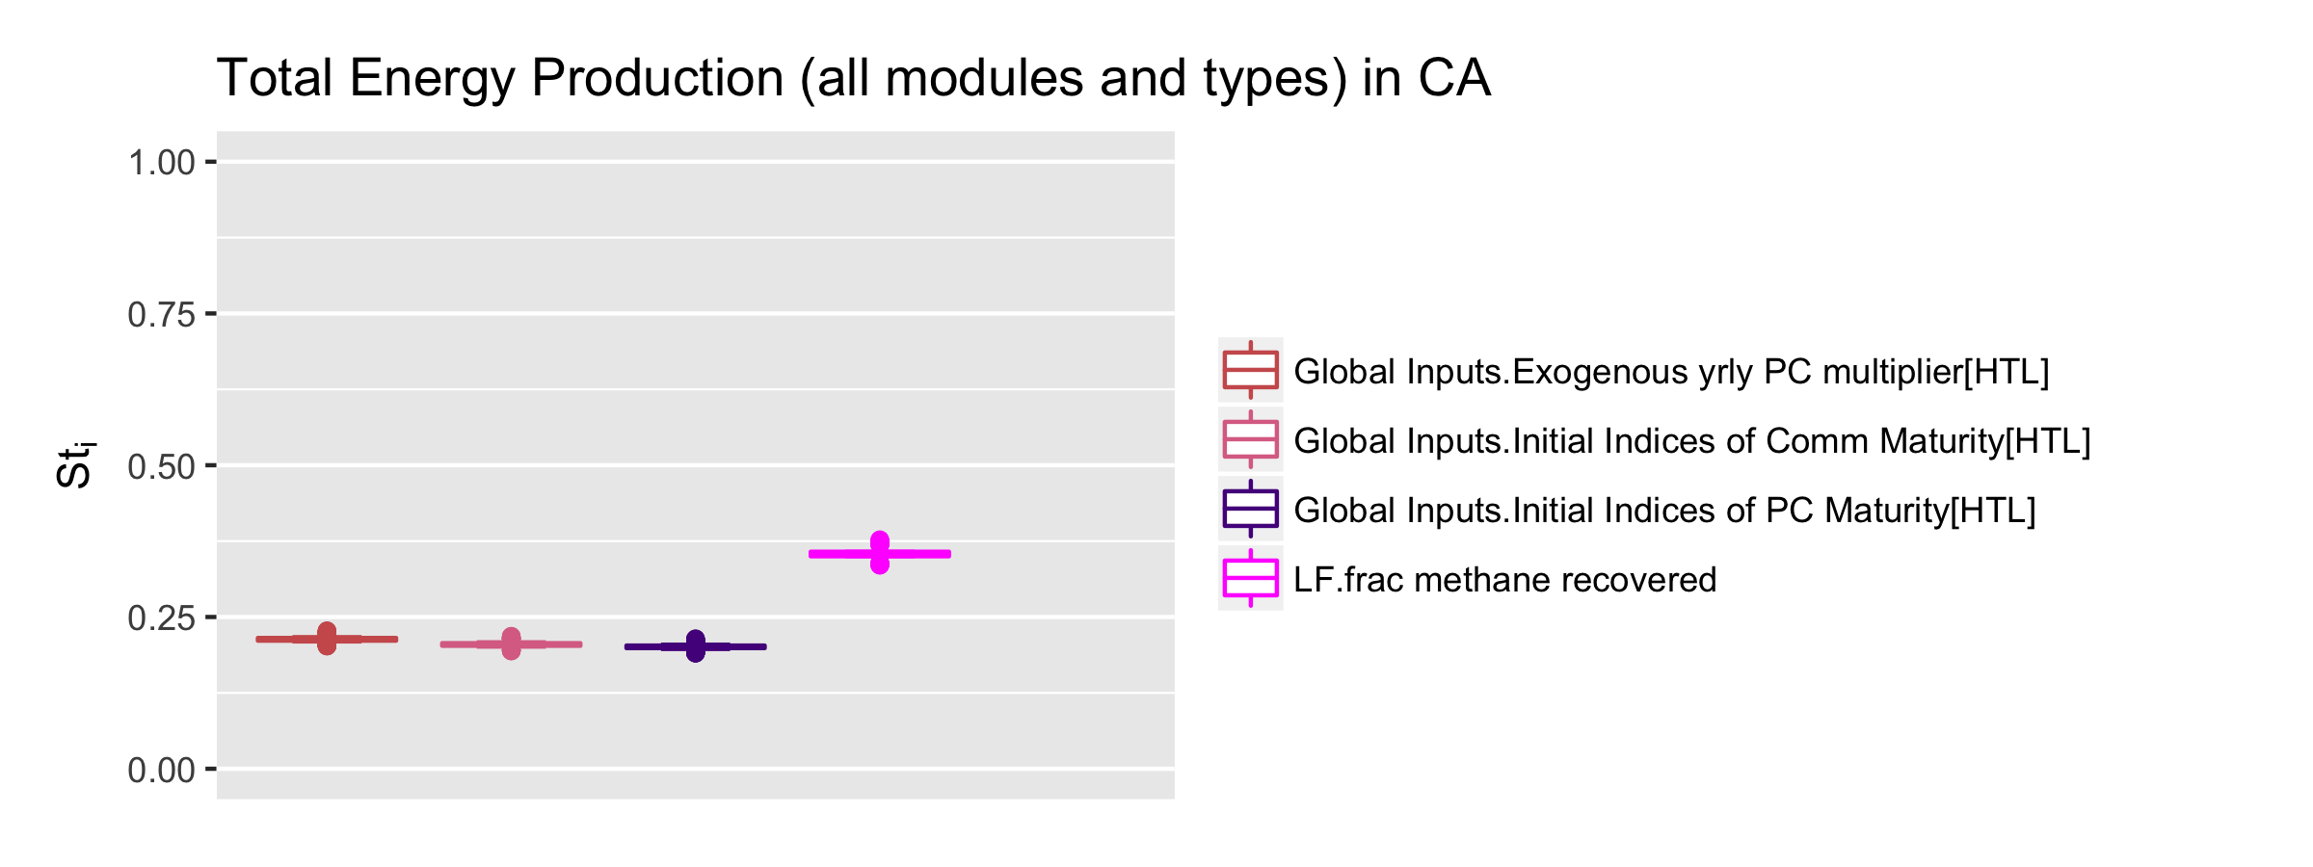
Total Effects Results for CA
Across all sources of biogas and energy conversion options assessed, the amount of biogas captured from landfills is the single most important factor when is comes to maximizing long-term energy production from biogas in CA.
We used industry average recovery rates and oxidation factors in the model and varied these conservatively.
Older landfills tend to be much less efficient at containing and capturing biogas. Efficiency values range from 0 to 95%, depending on the phase of the project (Lee et al., 2017)
Newer landfills have higher rates of oxidative loss of LFG. The IPCC suggests the loss of LFG though oxidation is 10%, studies have found this number to be between 30 and 44% (Chanton et al., 2009).
CH₄ Recovery (LF)
Pre-Comm Maturity (HTL)
Comm Maturity (HTL)
Technology Demo (HTL)
Notes:
Because landfills represent the largest potential source of energy from biogas (by up to 3X) the amount of methane recovered is a major factor affecting the total amount of energy produced from biogas. Landfills are very “leaky” with recovery rates as low as 40%. Modern sanitary landfills perform much better in terms of methane lost through leakage, but they have higher rates of oxidative methane loss (as high as 15%).
Interestingly, HTL maturity shows up as an important factor for overall energy production. <<<more here
CA policies – biocrude, oil prices, LCFS, SB1883
Across all sources of biogas and energy conversion options assessed, the amount of biogas captured from landfills is the single most important factor when is comes to maximizing long-term energy production from biogas in CA.
We used industry average recovery rates and oxidation factors in the model and varied these conservatively.
Older landfills tend to be much less efficient at containing and capturing biogas. Efficiency values range from 0 to 95%, depending on the phase of the project (Lee et al., 2017)
Newer landfills have higher rates of oxidative loss of LFG. The IPCC suggests the loss of LFG though oxidation is 10%, studies have found this number to be between 30 and 44% (Chanton et al., 2009).
Oxidative loss of LFG is a GHG control strategy

Slide 49
Results Among Biogas Sources: CA
Biogas Source | Model Factor | S_{ti}
POTW | CHP Efficiency | 0.15 d
 | HTL Technology Demo. | 0.30 a
 | HTL Comm. Maturity | 0.23 b
 | HTL Pre-Comm Maturity | 0.27 ab
 | Anaerobic Digester Yield | 0.23 b
CAFO | Rate of Return | 0.20 b
 | HTL Technology Demo | 0.32 a
 | HTL Comm. Maturity | 0.27 a
 | HTL Pre-Comm Maturity | 0.29 a
 | HTL Learning Rate | 0.22 b
Landfill | CH₄ Recovery | 0.73 a
HTL is attractive for manure and sludge
once sufficient demoing has been done
Maturity is very important for HTL to be
attractive in the WTE space b/c the incumbent
technologies are proven and mature
These results are not directional – competitive
interactions are present
Notes:
More here on competition between HTL and others

Slide 50
Results Among Technologies: CA
Technology | Model Factor | S_{ti}
CHP | Conversion Efficiency | 0.23 a
 | Renewable Elec Credits | 0.25 a
 | Yield Improvement | 0.22 a
CNG | Conversion Efficiency | 0.15 b
 | CH₄ Recovery | 0.20 b
 | On-Site Use | 0.60 a
PNG | Conversion Efficiency | 0.20 b
 | Renewable Elec Credits | 0.40 a
 | Yield Improvement | 0.158 b
 | CH₄ Recovery | 0.15 b
HTL | Rate of Return | 0.2 c
 | Technology Demo. | 0.80 a
 | Comm. Maturity | 0.68 a
 | Pre-Comm Maturity | 0.74 a
 | Learning Rate | 0.45 b
Electricity | Conversion Efficiency | 0.20 b
 | CH₄ Recovery | 0.45 a
 | Yield Improvement | 0.18 b
Notes:
More here on competition between HTL and others
Why does HTL sum to > 1?

Slide 51
ROTUS Results

Slide 52
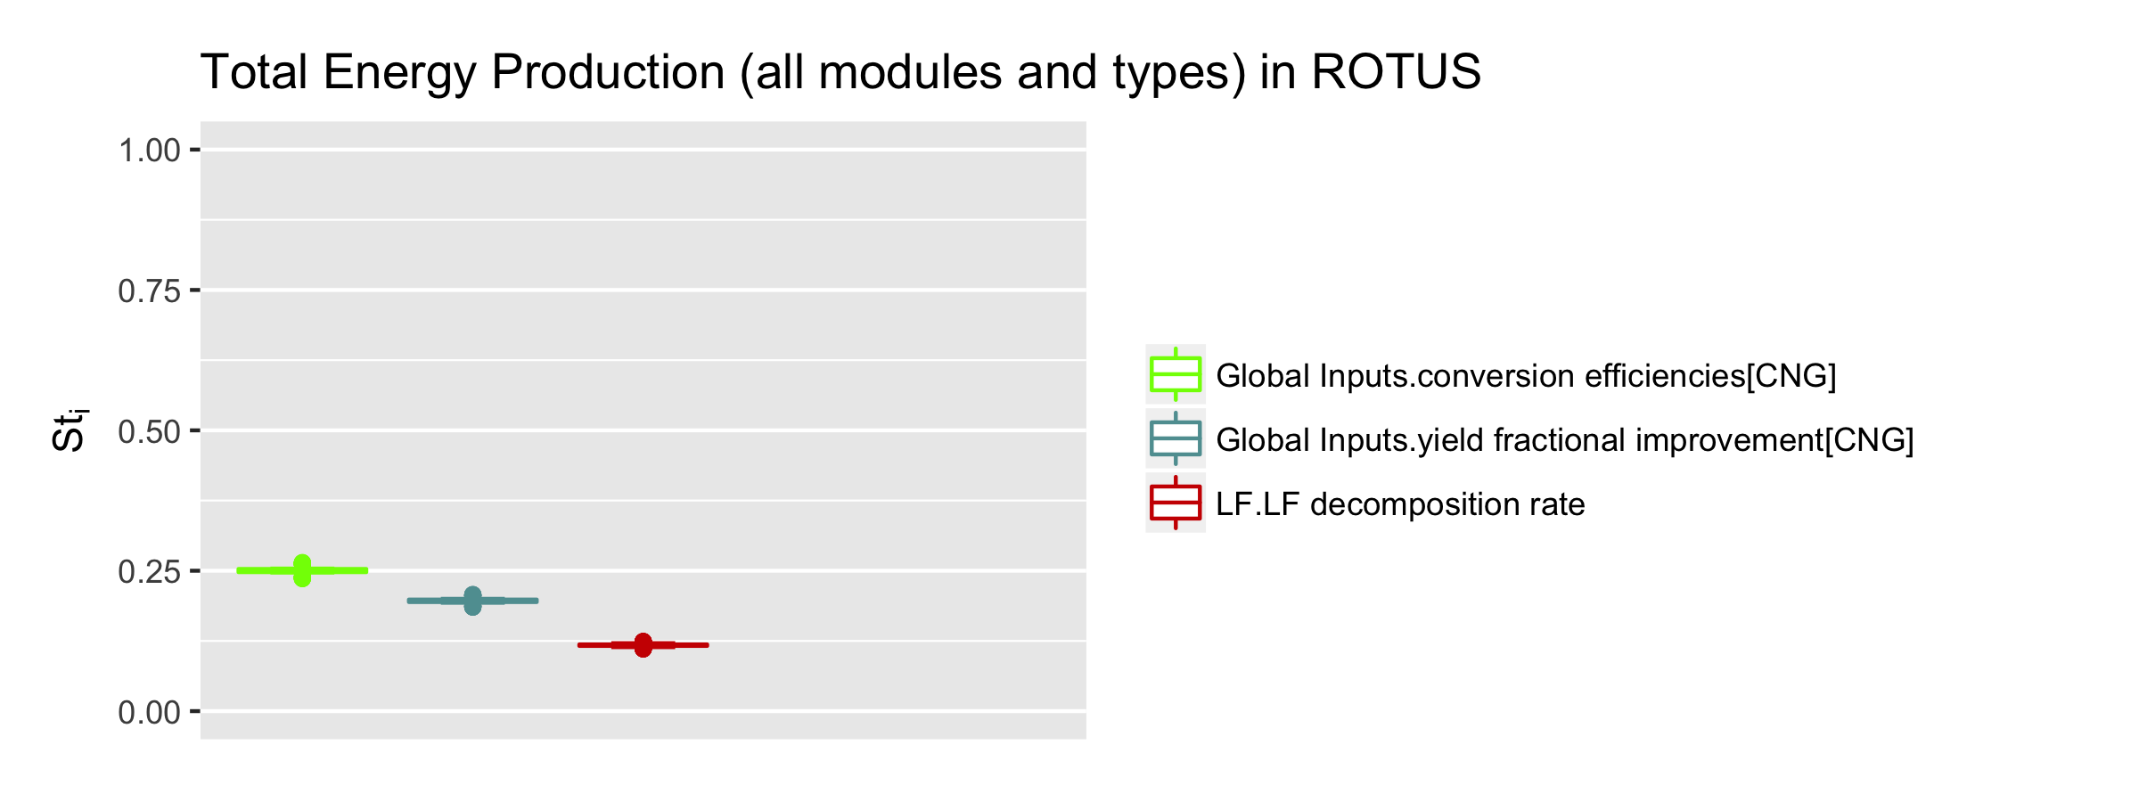
Total Effects Results for ROTUS
CNG is generally the most attractive technology across biogas sources.
We assume CNG is only used on-site
We assume wholesale NG prices for CNG
CNG is eligible for D3 RINS
In terms of total energy production, process efficiency and yield improvements for CNG are the most influential factors for total energy production from biogas in ROTUS.
Efficiency (CNG)
Yield Improvements (CNG)
Decomposition Rate (LF)
Notes:
Payback times for CNG are ~ 10 to 15 years for landfills, assuming only 50% utilization. For POTWs payback is ~ 6 to10 years for med and large POTWs.

Slide 53
Results Among Biogas Sources: ROTUS
Biogas Source | Model Factor | S_{ti}
POTW | CNG Conversion Efficiency | 0.12 b
 | CNG Yield Improvement | 0.08 b
 | AD Yield | 0.60 a
CAFO | Project Delay | 0.40 a
 | CNG Conversion Efficiency | 0.20 b
 | CNG Yield Improvement | 0.15 b
Landfill | CNG Conversion Efficiency | 0.20 a
 | Elec Conversion Efficiency | 0.12 b
 | CNG Yield Improvement | 0.15 ab
 | Elec Yield Improvement | 0.10 b
Technoeconomic parameters tend to
be the most influential determinants
of total energy production across
biogas sources.
Our default assumptions for efficiency
are conservative and based on current
installed capital – not state of the art.
Likewise, our assumptions for yields
are conservative.
AD yield ~ 280 M³ Mg⁻¹
Notes:
Across sources of biogas, technical improvements are the predominant system levers. Yield and efficiency for CNG are observed for all sources of biogas as highly influential. Also, anaerobic digester yield and project delays are highly impactful for maximizing energy production from POTWs and from CAFOs.

Slide 54
Results Among Technologies: ROTUS
Technology | Model Factor | S_{ti}
CHP | Conversion Efficiency | 0.30 a
 | Renewable Elec Credits | 0.25 a
 | Yield Improvement | 0.30 a
CNG | Conversion Efficiency | 0.40 a
 | Renewable ID Number Credit | 0.08 d
 | Yield Improvement | 0.30 b
 | Renewable Elec Credits | 0.20 c
PNG | Conversion Efficiency | 0.27 ab
 | Renewable Elec Credits | 0.30 a
 | Yield Improvement | 0.23 b
HTL | Comm. Maturity | 0.85 a
Electricity | Conversion Efficiency | 0.45 a
 | Yield Improvement | 0.40 a
Across most technologies, efficiency and process yields are among the most impactful factors.
For low TRL technologies, the commercial maturity is the single most important factor with regard to maximizing adoption.
Existing renewable energy policies (RINs and RECs) are also statistically influential.
Notes:
More here on competition between HTL and others
Why does HTL sum to > 1?

Slide 55
Discussion

Slide 56
Landfills are the Largest Source of Biogas
Landfills have potential to provide more than 600 10⁶ MJ of energy from biogas. Electricity is the most promising option, followed by CNG.
Because the potential energy in landfills is already in the form of biogas, and many of them already have capital installed for biogas capture, very little is needed for low cost, mature technologies to gain broad deployment.
For landfills, energy production potential between electricity generation and CNG are similar.
Because electricity and CNG from landfill biogas displace two different fossil fuels (diesel vs natural gas/coal) in two different energy sectors (heavy duty transportation vs electricity for transmission), they respond to very different levers.

Slide 57
Low TRL Technologies Need Increased Maturity to Become Competitive
HTL has potential for modest levels of adoption under certain conditions.
Based on the PNNL design report, the Nth plant commercial scale HTL facility can be cost-competitive and reduces the amount of sludge (disposal burden) by more than 90%.
This study illustrates the importance of industrial learning from demonstration-scale facilities.
In cases where HTL has modest levels of adoption, the rate of learning, pre-commercial, and commercial maturity is higher than what is in the default model.

Slide 58
Research and Development Efforts Drive Energy Production from Biogas
Technical process improvement – process efficiency and yield were important levers in nearly all technologies and across sources of biogas.
Similarly, anaerobic digester yield is a high-leverage factor for AD-based technologies.
In addition to R&D, existing policies are influential
In this study we did include existing local and federal policies.
Credits for renewable energy (RECs, RINs, and LCFS) are high-leverage factors for those pathways that are eligible.

Slide 59
Conclusions
The WTE industry has several mature technology options to choose from for conversion of biogas to energy, however the most attractive technology varies by the source of biogas.
Landfills offer the greatest biogas-to-energy potential. Because most landfills are required to install capture and flare equipment to comply with RCRA (1976) and CAA (1963), the most attractive options are those that require the least amount of additional capital (CNG and Electricity).
Also, landfills have an on-site need for CNG as a fuel for their vehicle fleet. This need is expected to expand, which will likely favor more investment in CNG technologies by landfills.
CAFOs and POTWs are similar because they both have a waste problem, which influences their investment decisions. Anaerobic digestion-based conversion technologies are currently mature and have experienced moderate levels of adoption at both POTWs and CAFOs.
Although for both CAFOs and POTWs, CNG has the highest maximum production, there are no clear statistical differences among the AD-based technologies assessed (CHP, CNG, PNG, and Elec) in terms of their relative strength of influence on the model’s output.
Notes:
At the more than 2,400 currently open and/or recently closed landfills across the U.S., there are approximately 600 operational waste-to-energy projects that convert municipal solid waste (MSW) to energy (Figure 1). Of the current projects, 75% convert biogas to electricity, 18% use direct incineration to generate electrical power, and 10% upgrade LFG to fuels and other products.

Slide 60
Conclusions cont.
Near and mid-term development of commercially mature technologies will result in the greatest energy production, but will not overcome the maturity gap for low TRL technologies.
Conversely, if large-scale development is delayed long enough that low-TRL technologies have a chance to mature, they could become much more competitive.
Their relative yield and efficiency enable them to become attractive investments once their risk and costs decline.

